Slide 1
MODULE 08: RESPIRATION ASSESSMENT AND MANAGEMENT
TCCC TIER 1
All Service Members
TCCC TIER 2
Combat Lifesaver
TCCC TIER 3
Combat Medic/Corpsman
TCCC TIER 4
Combat Paramedic/Provider

Slide 2

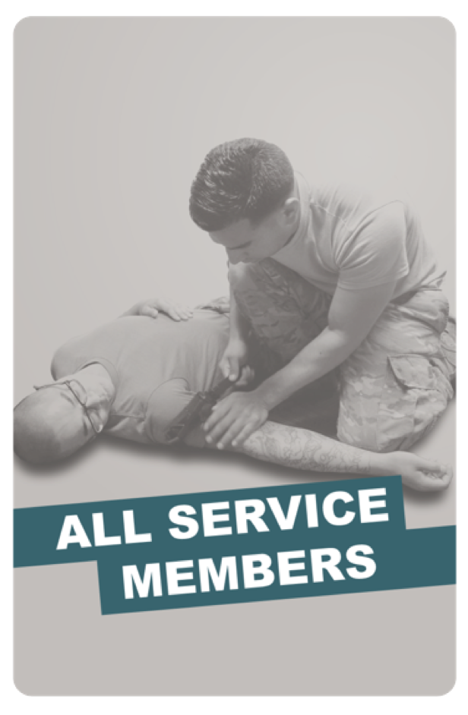
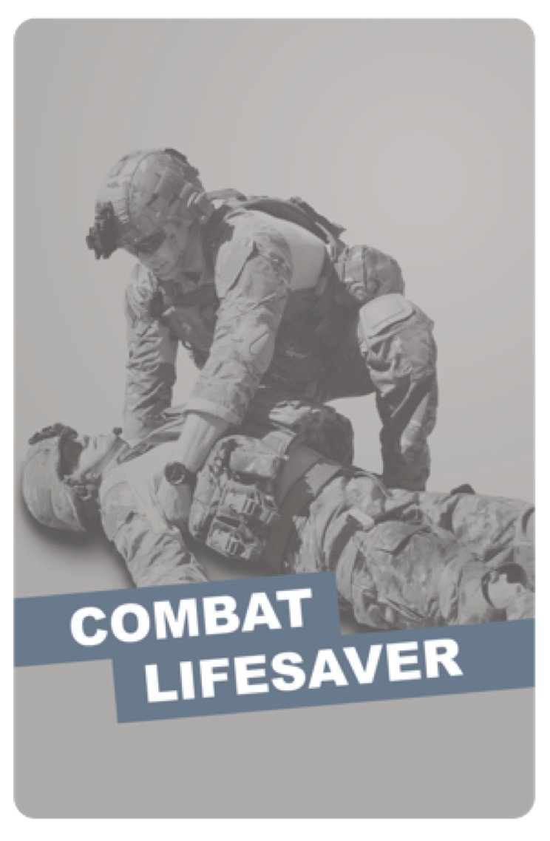
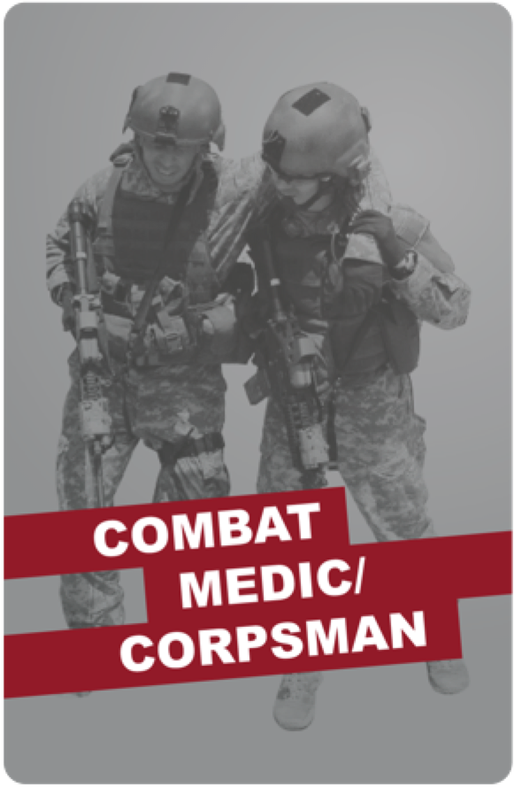
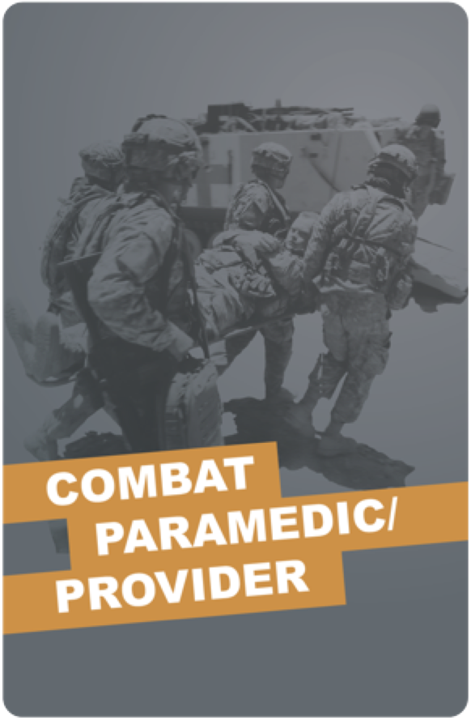
TACTICAL COMBAT CASUALTY CARE (TCCC) ROLE-BASED TRAINING SPECTRUM
ROLE 1 CARE
NONMEDICAL PERSONNEL
MEDICAL PERSONNEL
ASM
CMC
CPP
CLS
YOU ARE HERE
STANDARDIZED JOINT CURRICULUM
#TCCC-CLS-PPT-08 30 JUN 20
2

Slide 3
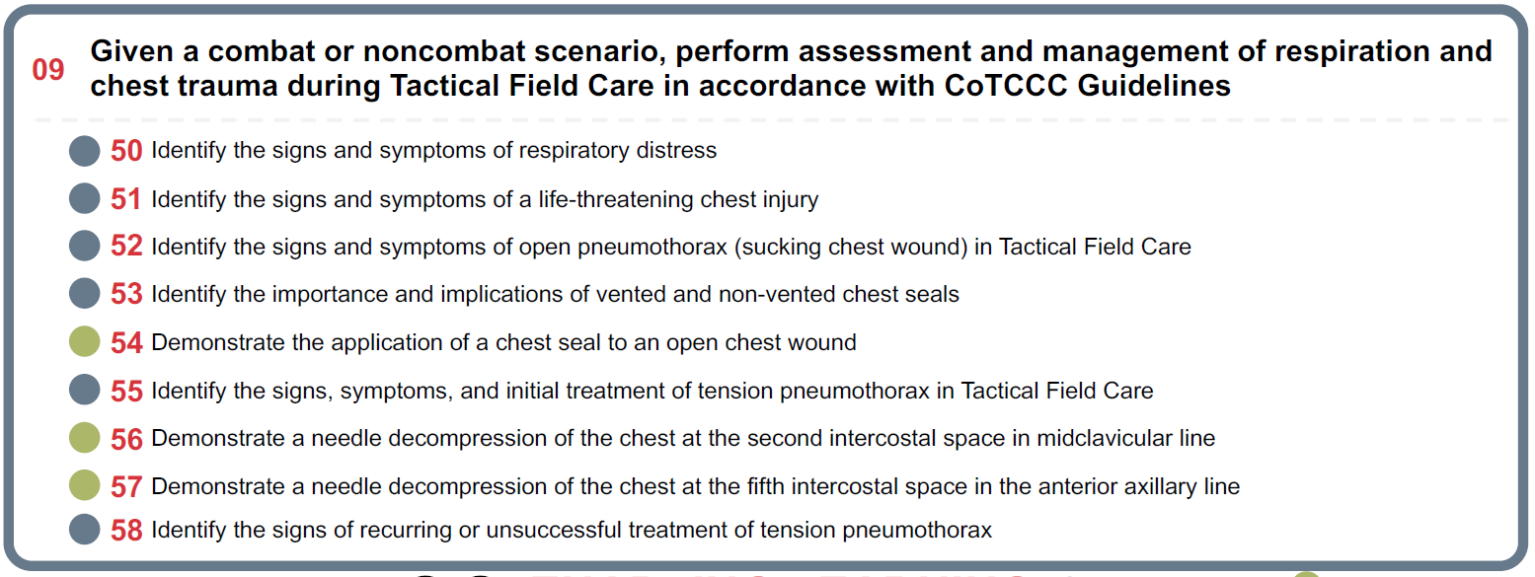





TERMINAL LEARNING OBJECTIVE
STUDENT LEARNING OBJECTIVES
Given a combat or noncombat scenario, perform assessment and management of respiration and chest trauma during Tactical Field Care in accordance with CoTCCC Guidelines
09
Identify the signs and symptoms of respiratory distress
Identify the signs and symptoms of a life-threatening chest injury
Identify the signs and symptoms of open pneumothorax (sucking chest wound) in Tactical Field Care
Identify the importance and implications of vented and non-vented chest seals
Demonstrate the application of a chest seal to an open chest wound
Identify the signs, symptoms, and initial treatment of tension pneumothorax in Tactical Field Care
Demonstrate a needle decompression of the chest at the second intercostal space in midclavicular line 57 Demonstrate a needle decompression of the chest at the fifth intercostal space in the anterior axillary line 58 Identify the signs of recurring or unsuccessful treatment of tension pneumothorax
09
ENABLING LEARNING OBJECTIVES (ELOs)
= Cognitive ELOs
= Performance ELOs
3
#TCCC-CLS-PPT-08 25 JAN 20

Slide 4


MARCH PAWS
TACTICAL FIELD CARE
CIRCULATION/SHOCK
DURING LIFE-THREATENING
AFTER LIFE-THREATENING
M A R C H
MASSIVE BLEEDING #1 Priority
P
PAIN
AIRWAY
A
ANTIBIOTICS
R RESPIRATION (breathing)
C CIRCULATION
_{H} HYPOTHERMIA/ HEAD INJURIES
W
WOUNDS
S
SPLINTING
4

Slide 5



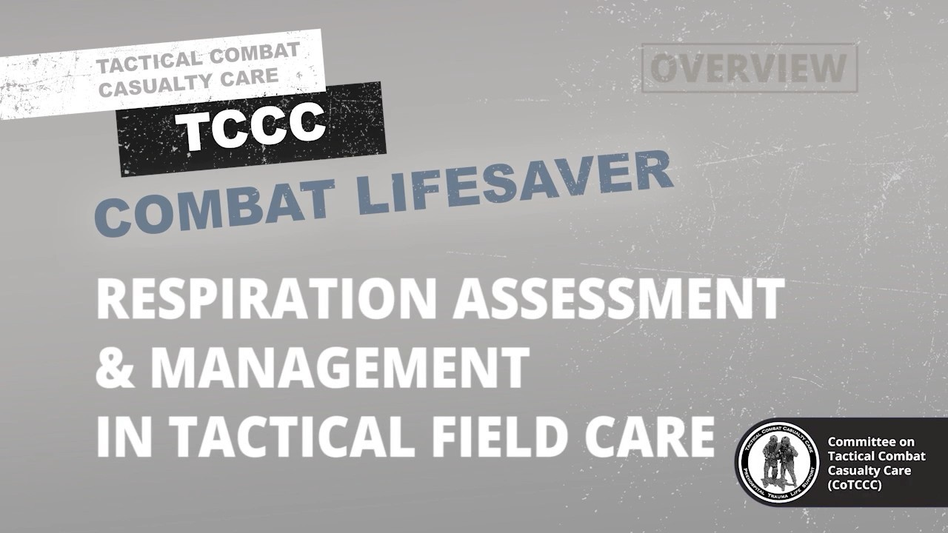
RESPIRATION ASSESSMENT AND MANAGEMENT IN TFC
RESPIRATION OVERVIEW

Slide 6
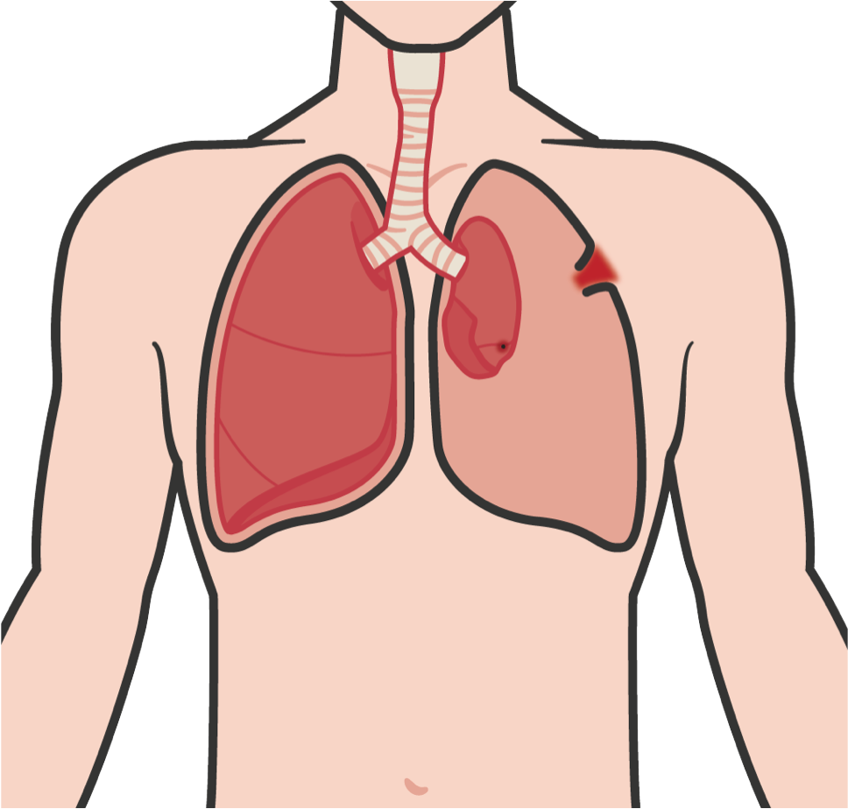
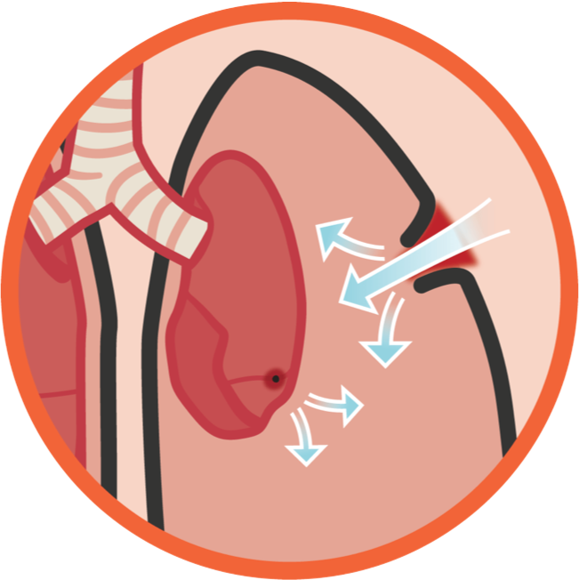
RESPIRATION ASSESSMENT AND MANAGEMENT IN TFC
LIFETHREATENING CHEST INJURY
Respiratory distress means DIFFICULTY BREATHING (rapid or abnormally slow breathing), in other words, it is difficult for the casualty to get air in or out
The pleural space between the lungs and chest wall naturally has negative pressure, which helps the lungs to collapse (exhale) and expand (inhale)
With either a BLUNT or PENETRATING INJURY to the chest wall or lungs, air may counteract the lung’s natural tendency to expand and collapse
  This is due to positive pressure replacing negative pressure
  It results in air being trapped in the pleural space, putting pressure on the affected lung
  This forces the lung to collapse and reduces the ability to get oxygen to the body

Slide 7
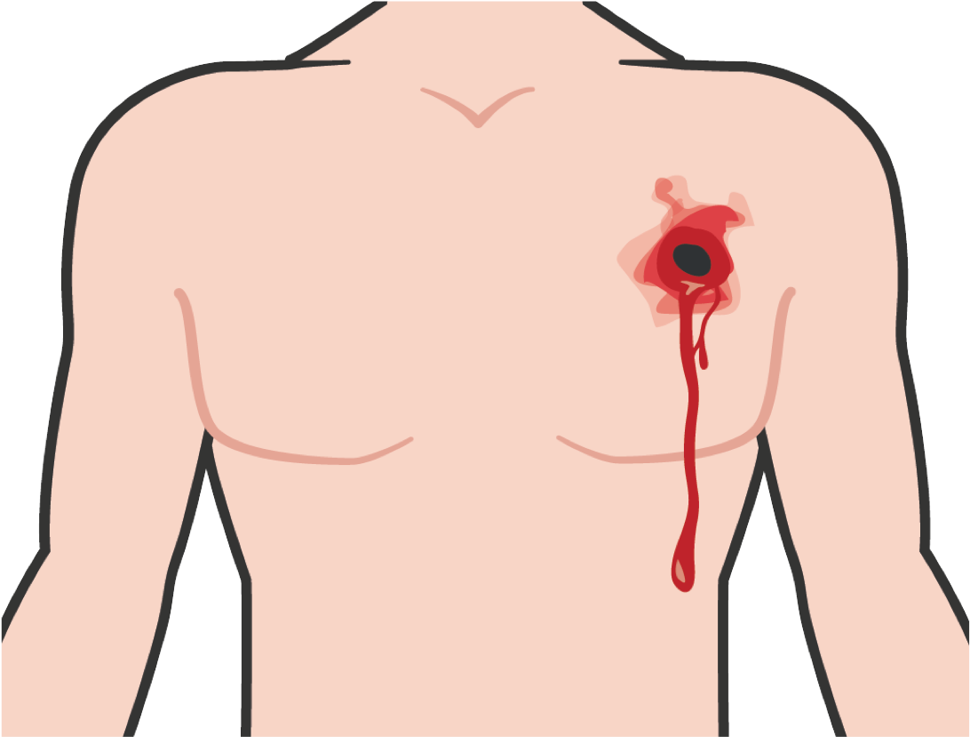
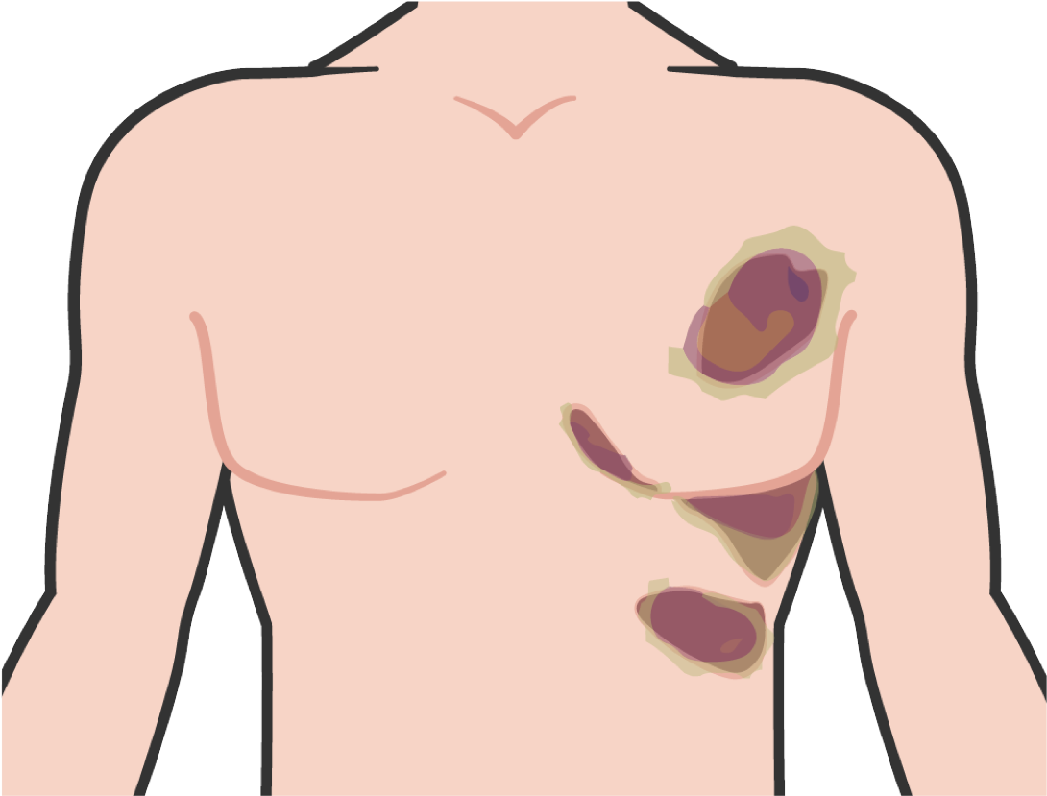
LIFE-THREATENING CHEST INJURY
RESPIRATION ASSESSMENT AND MANAGEMENT IN TFC
REMEMBER:
These injuries can lead to a tension pneumothorax
This is the second- leading cause of preventable death
Gunshot or shrapnel
Blunt force trauma (force from an IED
wound to the chest (penetrating trauma)
explosion, high-impact vehicle accident (chest hitting steering wheel), etc.)
Bruising, contusions (swelling around the
M A R C H
chest, back or rib cage), crepitus that is felt or heard (crackling, popping, grating)
ANY deformities of the chest

Slide 8


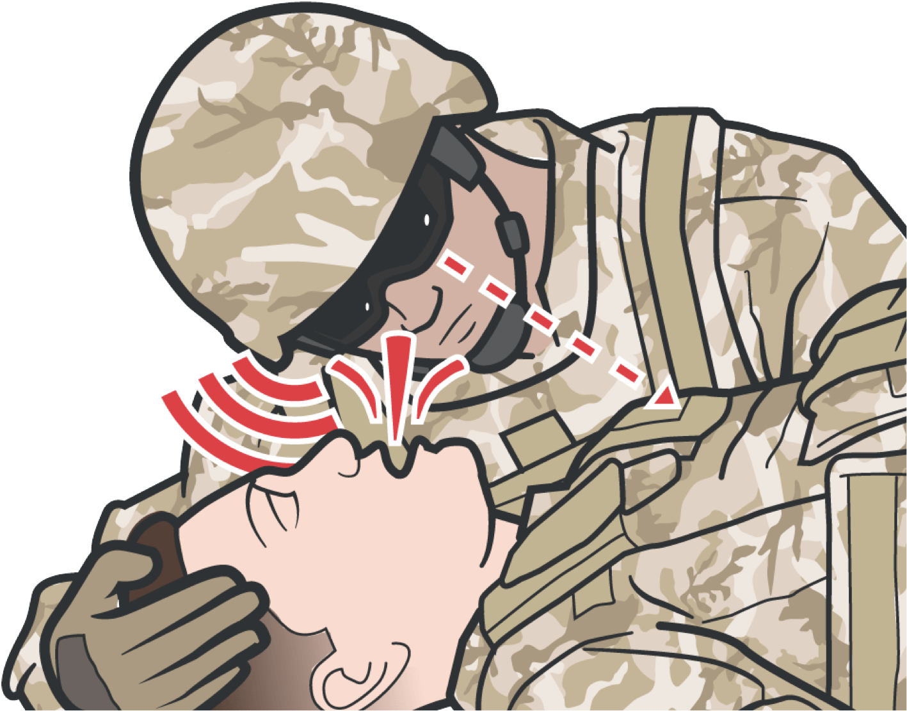

IDENTIFYING
TENSION PNEUMOTHORAX
RESPIRATION ASSESSMENT AND MANAGEMENT IN TFC
SIGNS AND SYMPTOMS OF PROGRESSIVE RESPIRATORY DISTRESS:
Progressive difficulty breathing (labored and rapid breathing worsening overtime)
Shortness of breath
Confusion/lightheaded and/or agitation due to lack of oxygen
Bluish discoloration around mouth and lips
Rapid pulse
Distended jugular veins
Remember! Airway and Respiration are NOT addressed in CUF and must be addressed in TFC
M A R C H

Slide 9
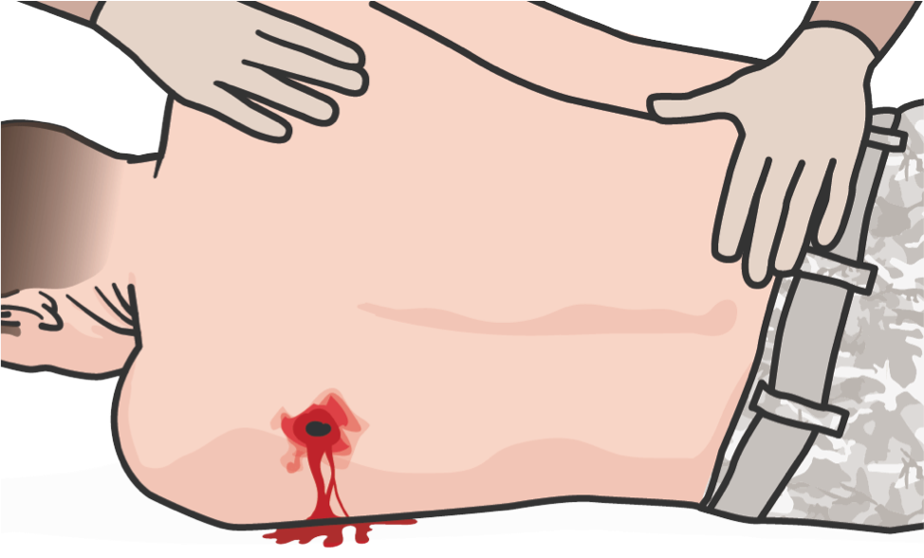
SIGNS AND SYMPTOMS OF OPEN PNEUMOTHORAX OR SUCKING CHEST WOUND IN TFC
RESPIRATION ASSESSMENT AND MANAGEMENT IN TFC
A casualty with an open chest wound will
exhibit ONE OR MORE of the following signs and symptoms:
REMEMBER:
▪
A “sucking” or “hissing” sound when the casualty inhales
Difficulty breathing
A puncture wound of the chest Froth or bubbles around the injury Coughing up blood
Blood-tinged sputum (spit)
▪
If you are not sure if the wound has penetrated the chest wall completely, treat the wound as though it were an open chest wound
▪
▪
▪
Open Pneumothorax
▪
If multiple wounds are found, treat them in the order in which you find them
▪
▪
M A R C H

Slide 10

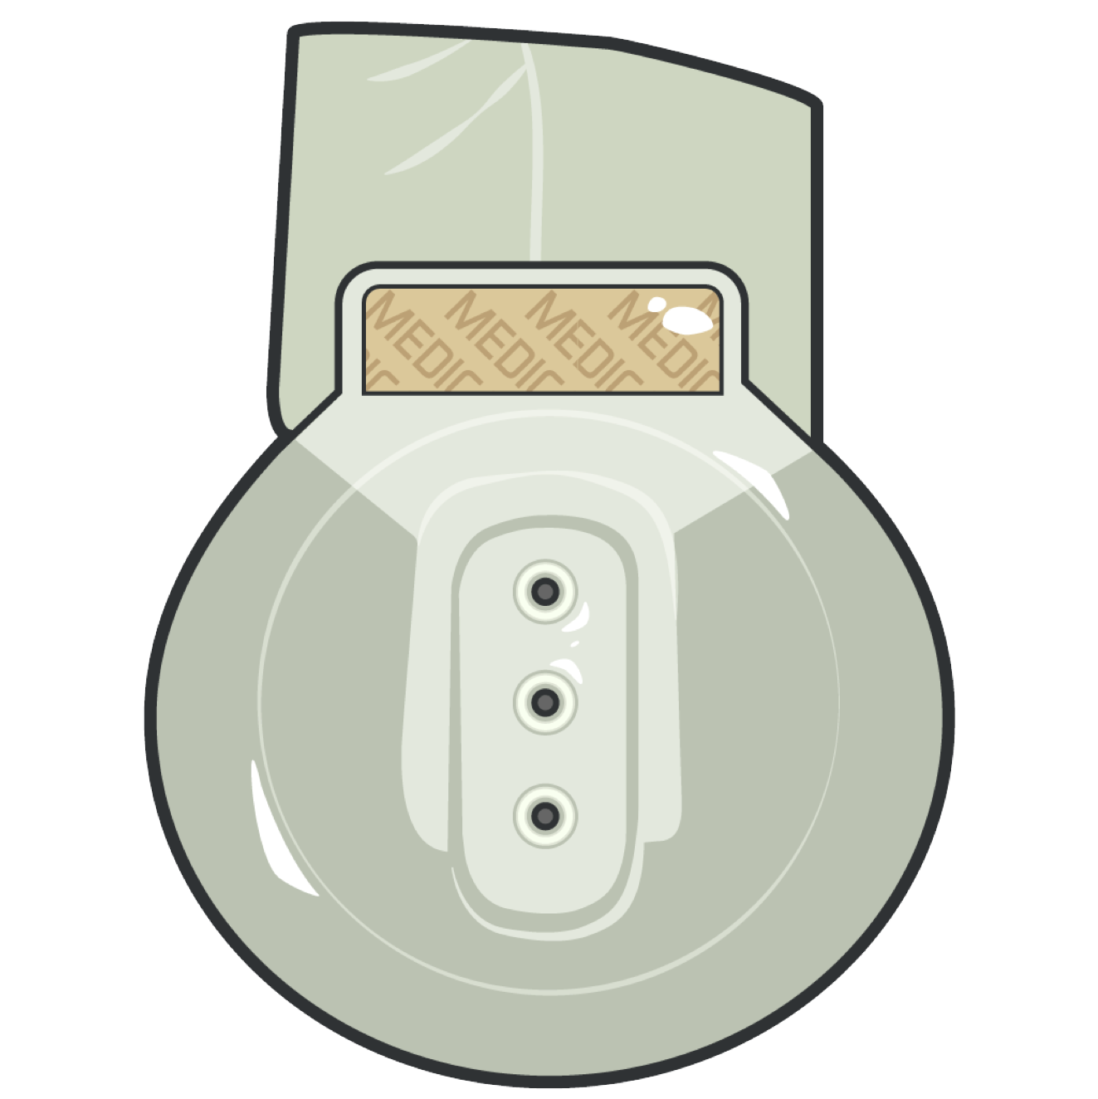
RESPIRATION ASSESSMENT AND MANAGEMENT IN TFC
VENTED CHEST SEALS
Vented chest seals are for treating penetrating wounds to the chest
Vented chest seals allow air to escape out of the chest while nonvented chest seals do not
The injured lung will remain partially collapsed, but the mechanics of respiration will be better

Slide 11
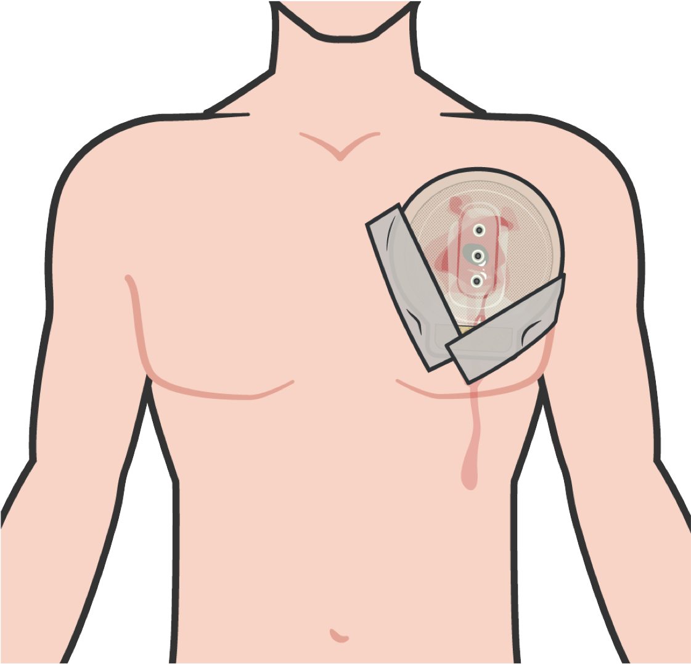

VENTED AND NONVENTED CHEST SEALS
RESPIRATION ASSESSMENT AND MANAGEMENT IN TFC
Recommended treatment for open or sucking chest wounds is
prompt application of a vented chest seal:
If vented chest seal is NOT available, a nonvented chest seal should be used
Vented chest seals allow air to escape out of the chest while nonvented chest seals do not
When the casualty inhales, the plastic should be sucked against the wound, preventing the entry of air
When the casualty exhales, trapped air should be able to escape from the wound and out the valve
MONITOR the casualty closely and if their condition
worsens, you should suspect a tension pneumothorax.
Treat this by burping or temporarily removing the dressing.
M A R C H
11

Slide 12
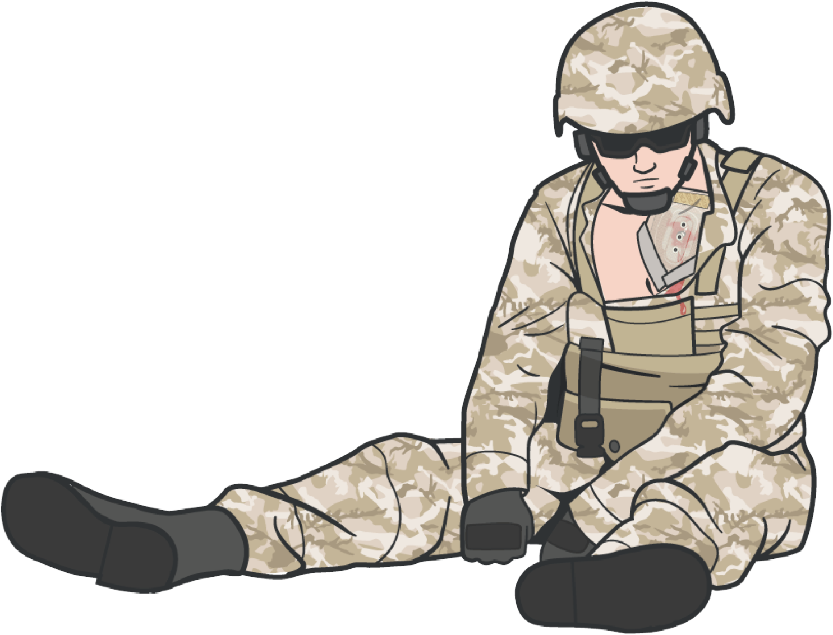
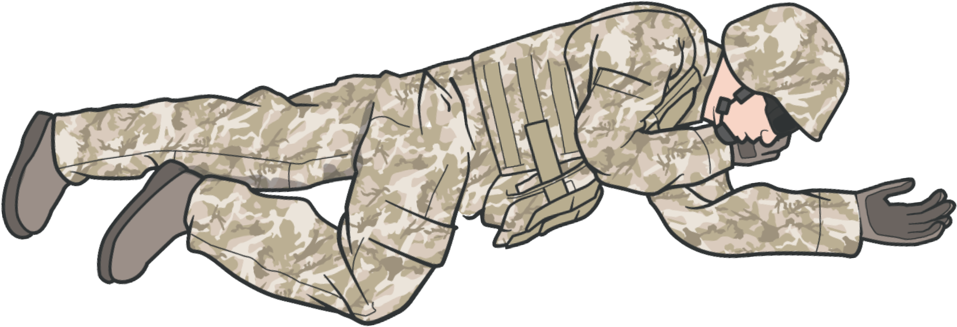
RESPIRATION ASSESSMENT AND MANAGEMENT IN TFC
POSITION AFTER OCCLUSIVE DRESSING TREATMENT
If the casualty is unconscious, place § the casualty in the recovery position
If the casualty is conscious, allow the casualty to adopt the sitting position if breathing is more comfortable

Slide 13
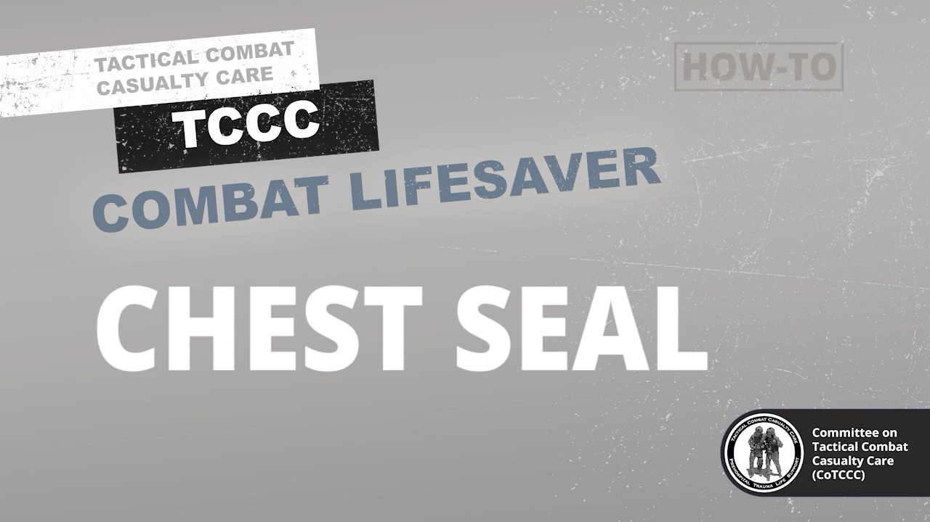
RESPIRATION ASSESSMENT AND MANAGEMENT IN TFC
CHEST SEAL
Video can be found on DeployedMedicine.com

Slide 14
SKILL STATION
Respiration (Skill) Chest Seal

Slide 15
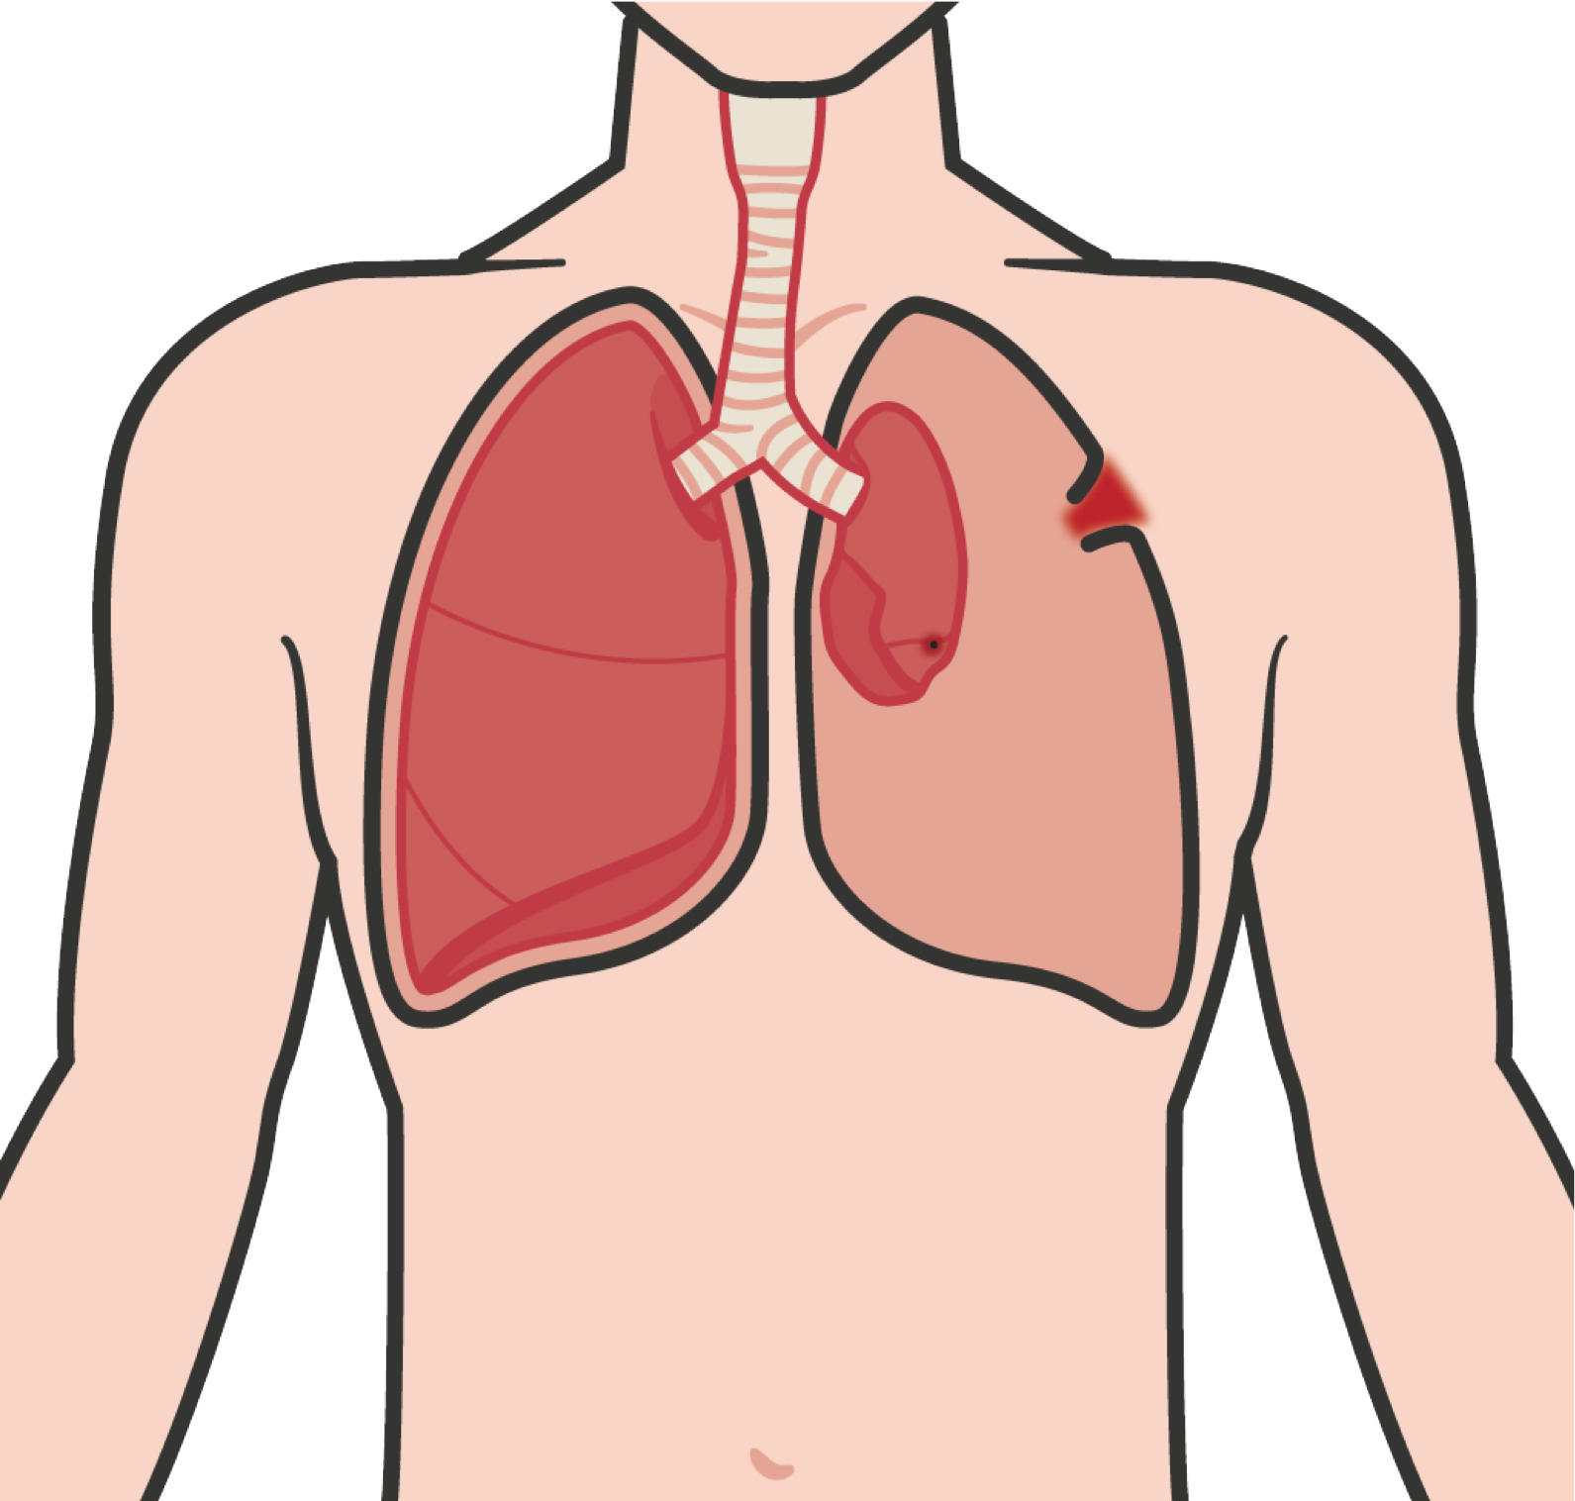


TENSION PNEUMOTHORAX
RESPIRATION ASSESSMENT AND MANAGEMENT IN TFC
A tension pneumothorax is the second-leading cause of preventable deaths on the battlefield
As a tension pneumothorax develops, air enters the chest cavity through the wound WITH EVERY BREATH
Injured lung tissue acts as a one-way valve, TRAPPING more and more air between the lung and the chest wall
PRESSURE BUILDS UP AND COMPRESSES BOTH LUNGS AND THE HEART
M A R C H

Slide 16
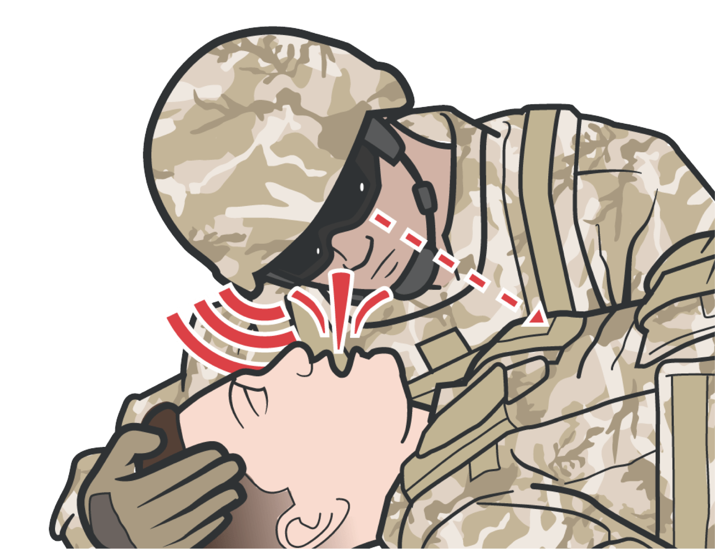
CONSIDER TENSION PNEUMOTHORAX IN TACTICAL FIELD CARE
RESPIRATION ASSESSMENT AND MANAGEMENT IN TFC
Caused by SIGNIFICANT TORSO TRAUMA or primary blast injury followed by severe/progressive respiratory distress (a respiratory rate >20 breaths per minute)
The recommended treatment of suspected tension pneumothorax is Needle Decompression of the Chest (NDC)
M A R C H

Slide 17
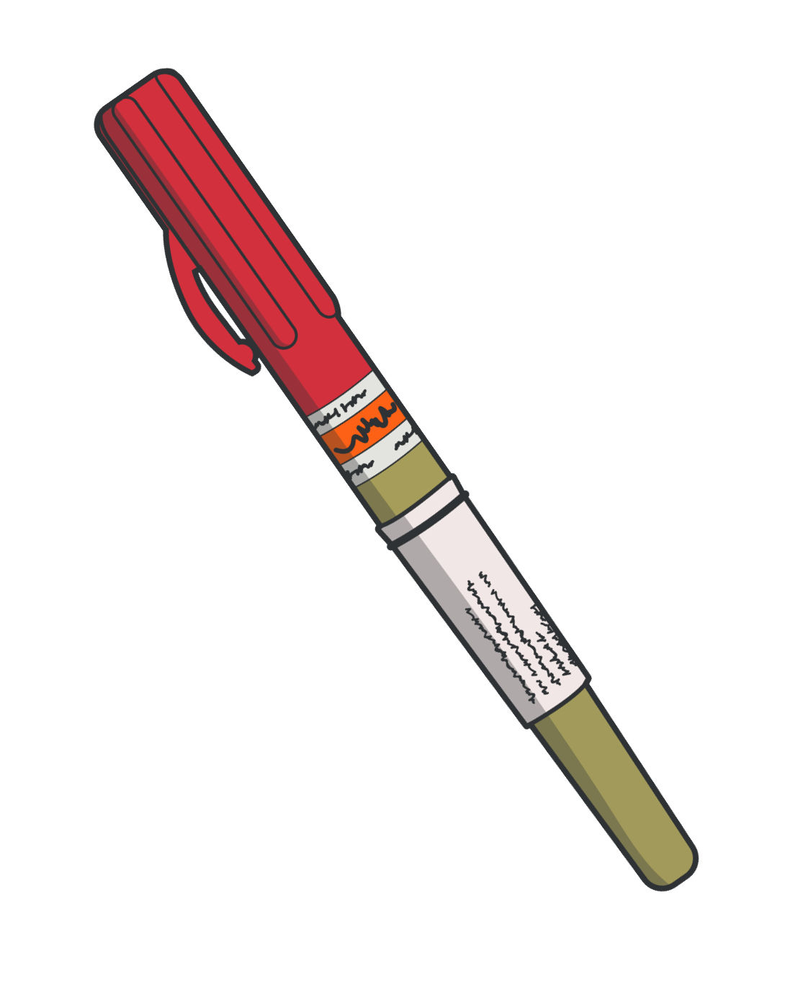

UNSUCCESSFUL TREATMENT OR RECURRENCE OF TENSION PNEUMOTHORAX
RESPIRATION ASSESSMENT AND MANAGEMENT IN TFC
Burp the chest seal if one is in place
If initial NDC does not result in improvement, a second NDC should be attempted at the alternate recommended site
If tension pneumothorax initially responds to NDC, but symptoms later recur, then repeat NDC at the same site right beside the original NDC
If no improvement is noted with the second NDC, proceed with circulation assessment and treatment following the MARCH protocol
M A R C H
DO NOT put NDC through a chest seal!
Use alternate site instead

Slide 18
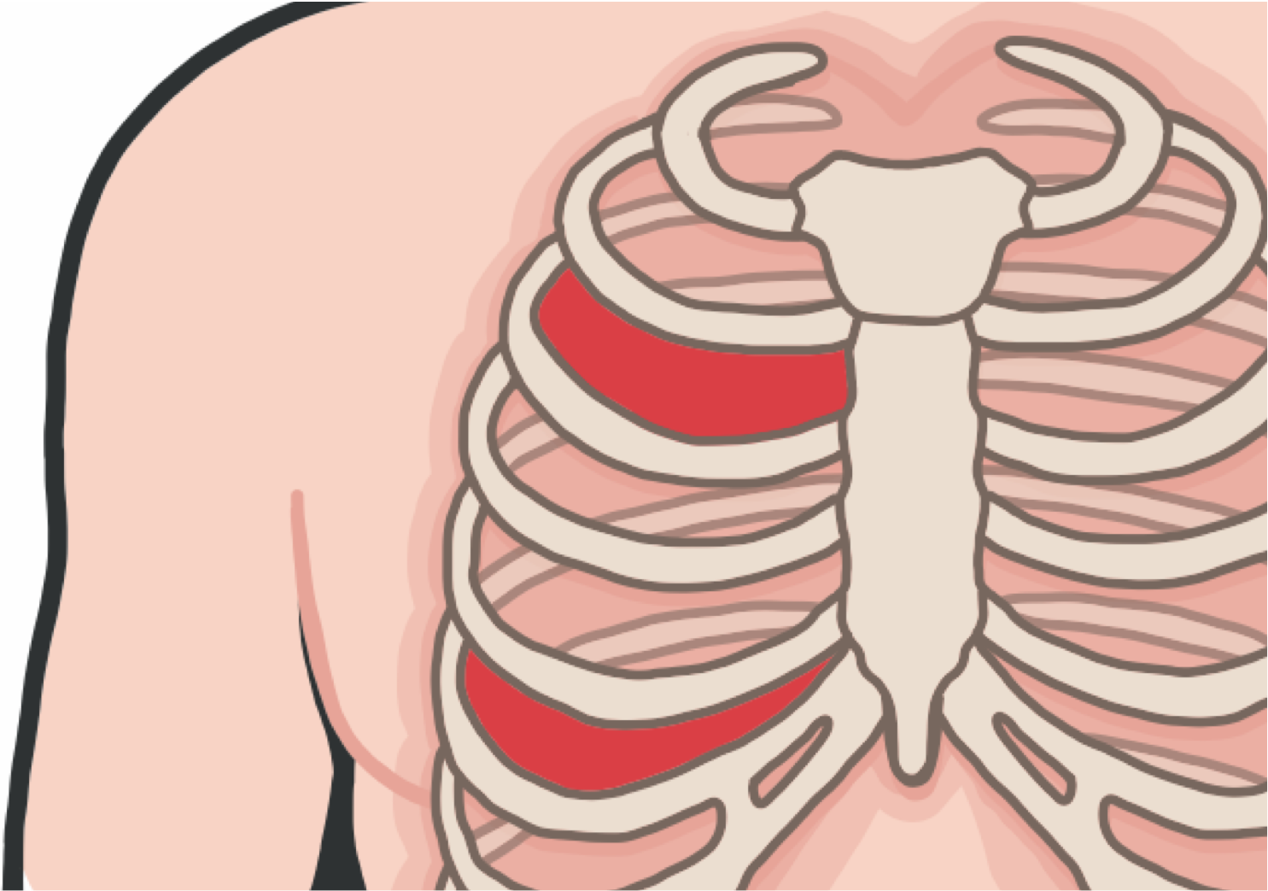
NDC SITE SELECTION
RESPIRATION ASSESSMENT AND MANAGEMENT IN TFC
Site selection is based on the mechanism of injury AND physical findings
Use either the second (A) or fifth (B) intercostal space (either is preferred)
If the needle is used at the second intercostal space, ensure the site selection is OUTSIDE the nipple line
M A R C H

Slide 19
RESPIRATION ASSESSMENT AND MANAGEMENT IN TFC
POSITION AFTER NDC TREATMENT
If the casualty is unconscious, place the casualty in the recovery position
If the casualty is conscious, allow the casualty to adopt the sitting position, if breathing is more comfortable
M A R C H

Slide 20
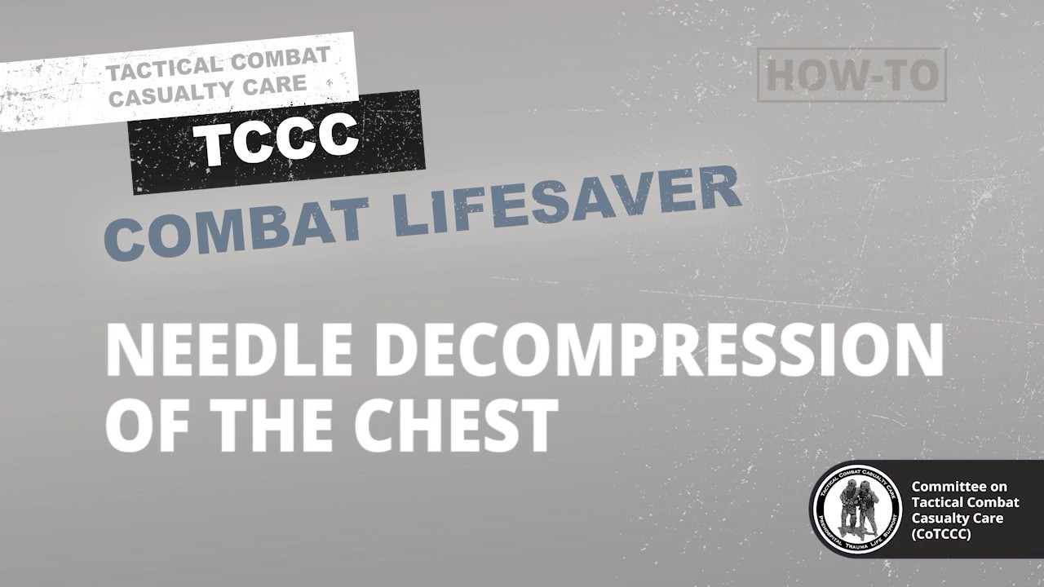
RESPIRATION ASSESSMENT AND MANAGEMENT IN TFC
NEEDLE DECOMPRESSION OF THE CHEST
Video can be found on DeployedMedicine.com

Slide 21
SKILL STATION
Respiration (Skill)
Needle Decompression of Chest (NDC)

Slide 22
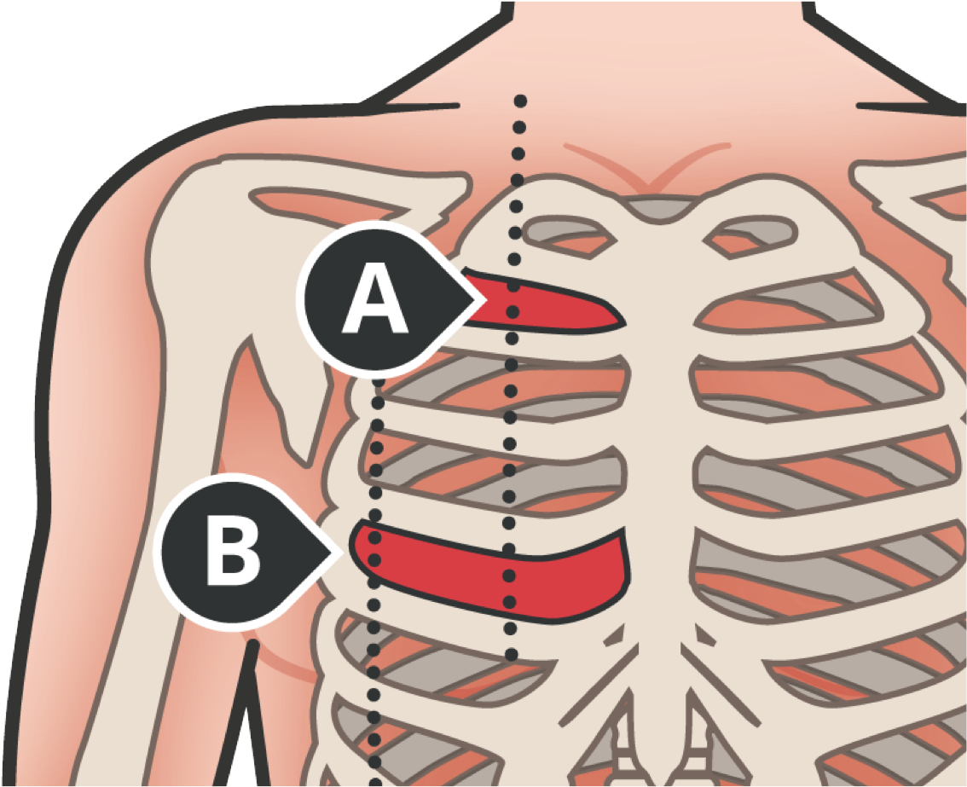
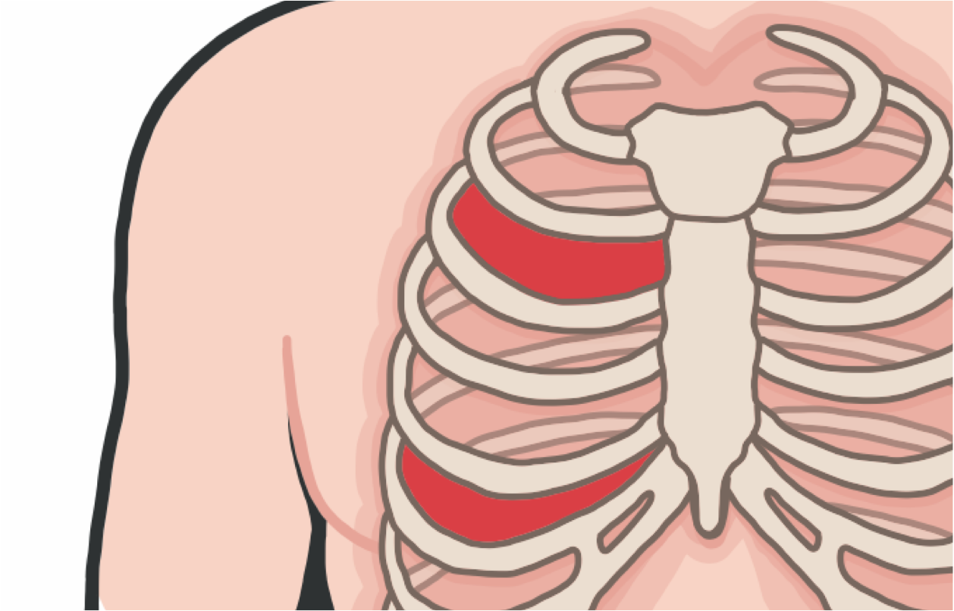

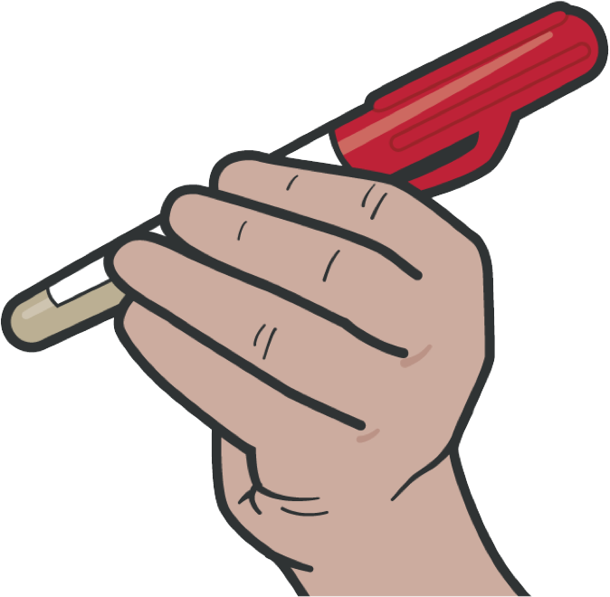
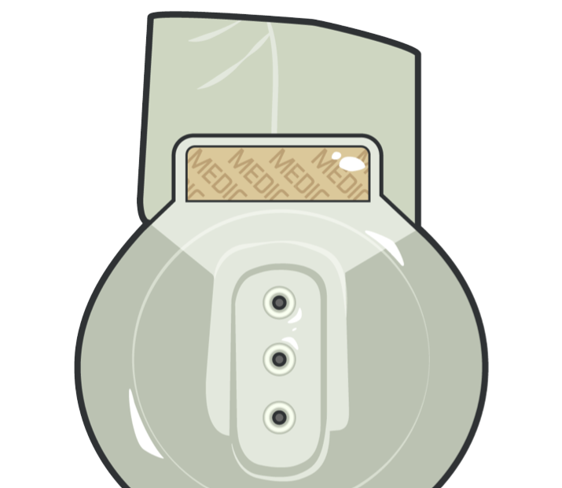

RESPIRATION ASSESSMENT AND MANAGEMENT IN TFC
SUMMARY
We identified the signs and symptoms of an open pneumothorax
We discussed the treatment options for an open pneumothorax
We identified the signs and symptoms of a tension pneumothorax
We discussed the treatment for a tension pneumothorax
Both types of chest injuries (sucking chest wounds and tension pneumothorax) WILL REQUIRE advanced evaluation by medical personnel and evacuation
Tension pneumothorax is a PREVENTABLE cause of death

Slide 23
CHECK ON LEARNING
What is a tension pneumothorax?
How should you treat an open chest wound?
What should you do if you suspect a casualty has a tension pneumothorax?

Slide 24
ANY QUESTIONS?

